Slide 1
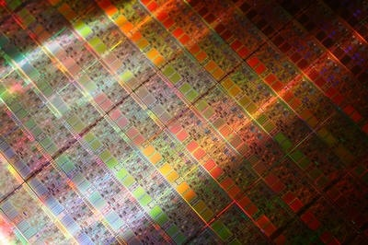
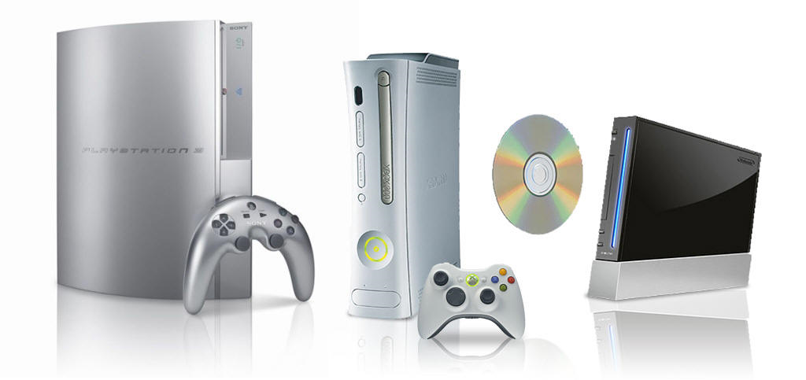
Introduction
Computer Organization and Design
Wu changze
Notes:
http://www.engr.colostate.edu/~sudeep/teaching/lectures_452.htm
课程介绍
计算机概况和发展现状，摩尔定律
计算机面临的能量墙
计算机性能评估方法
阿姆达尔定律，如何改进计算机性能

Slide 2
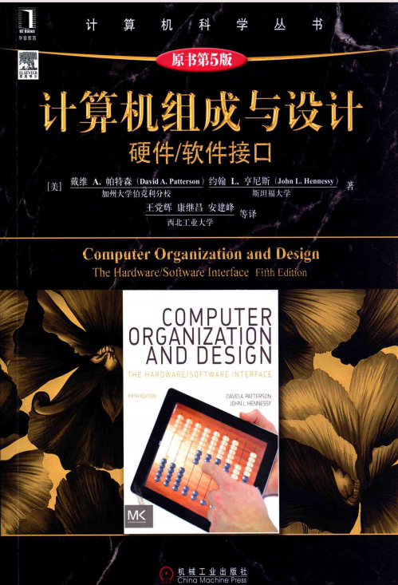
Course Logistics
Instructor
Wu changze (13618392903 QQ5715488)
Office Hours: Wed.: 1:30-2:30 pm ( 512)
Textbook (Required)
David A. Patterson and John L. Hennessy, Computer Organization and Design: The Hardware/Software Interface, 5th Edition, Morgan Kaufmann, October 2008

Slide 3
What You Should Know
Prerequisite
Intro to Microprocessors
Basic digital logic design
FSM, synchronous design
Basic structure of a microprocessor
including memory subsystem, I/O
Addressing modes
for operands in instructions
Some experience with assembly language programming, debugging

Slide 4
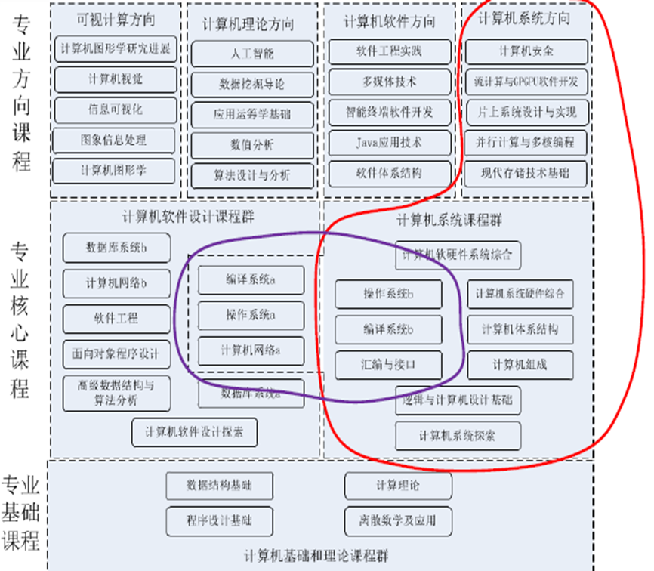
课程定位

Slide 5
Evaluation and Grading
Homework Assignments (5): 10%
Class Participation: 10%
Quizzes (4-5): 10%
Examinations (closed book/notes): 40%
Comprehensive Final: 40%
Experiments: 20%
Project: 20%
Grading scale
>95% A+ 80-84% B+ 65-69% C+ <40% F
90-94% A 75-79% B 55-64% C
85-89% A- 70-74% B- 40-55% D

Slide 6
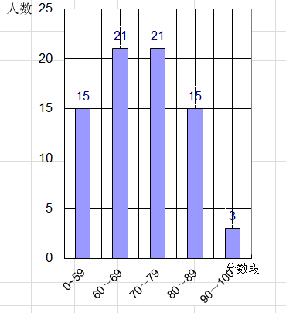
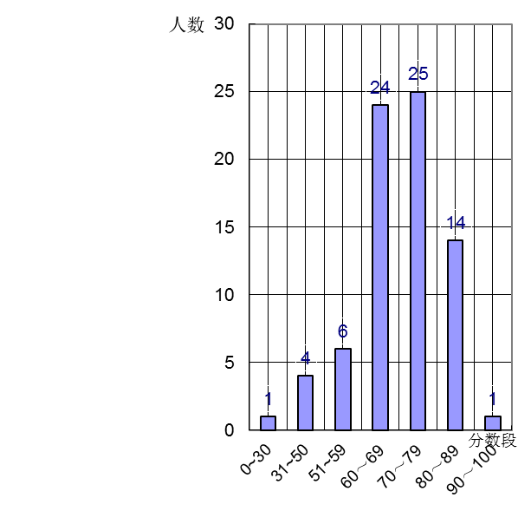
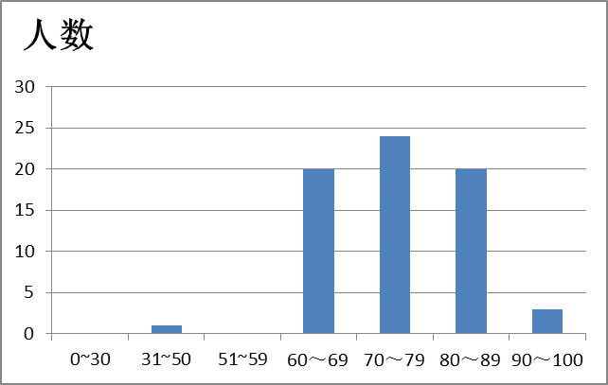
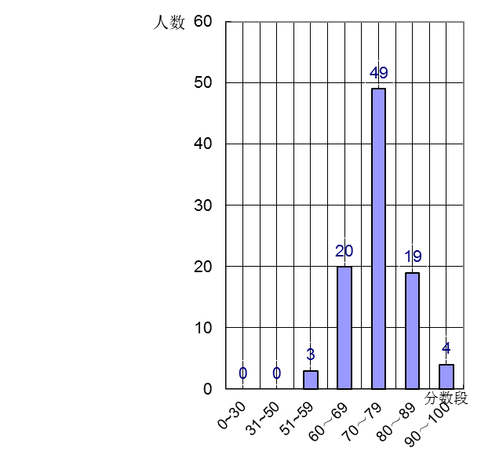
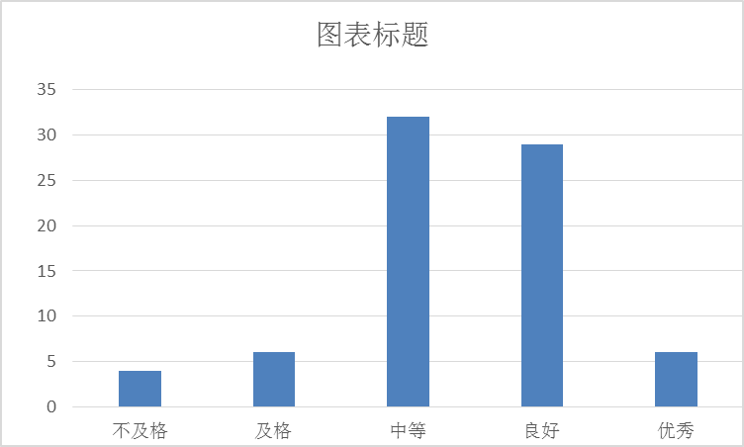
Grade Distributions in Recent Years
2007
2009
2010
2011
2012
2013

Slide 7
Evaluation and Grading
Homework Policy
No late submissions accepted unless you have a valid excuse
Attendance
Your responsibility to keep track of what you missed if absent
Keep track of assignments and due dates
Academic Honesty
All submitted work should be your own. Plagiarism/cheating will result in all students involved getting a zero on the assignment/exam and potentially a failing grade. Refer to the CQU Academic Integrity Guidelines for more information.
Appointment
I encourage you to make at least one appointment with me during the semester for advice or to discuss research opportunities, research ideas, course suggestions, concerns etc.

Slide 8
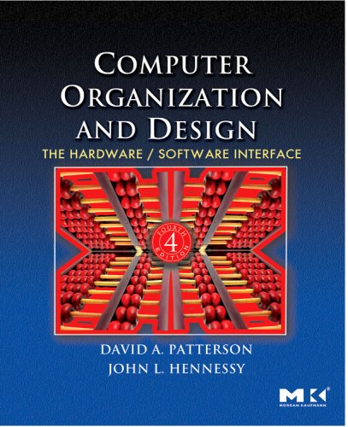
Scope of Course
Lecture Topics:
Instruction Set Architectures (MIPS/ARM)
Computer Arithmetic
VLIW and Superscalar Processor Design
Memory Hierarchy, Storage and I/O
Multicores and multiprocessors
Interconnection Networks

Slide 9
What you will Learn
How are programs written in high level languages (C or Java) translated into the language of the hardware, and how does hardware execute the resulting program?
What is the interface between software and hardware, and how does software instruct hardware to perform needed functions? ISA (instruction set architecture)
What determines the performance of a program, and how can software programmers and hardware designers improve performance?
What are the reasons for and consequences of the recent switch from sequential to parallel processing?

Slide 10
What you will Learn
The implementation of a machine has two components: organization and hardware. The term organization includes the high-level aspects of a computer’s design, such as the memory system, the bus structure, and the internal CPU (central processing unit—where arithmetic, logic, branching, and data transfer are implemented) design

Slide 11

Don’t Forget …
Ask Questions in class!

Slide 12
Chapter 1
Computer Organization and Design
Computer Abstractions and Technology

Slide 13
The Computer Revolution
§1.1 Introduction
Progress in computer technology
Underpinned by Moore’s Law
Makes novel applications feasible
Computers in automobiles
Cell phones
Human genome project
World Wide Web
Search Engines
Computers are pervasive
Notes:
Underpin 支持
Pervasive adj persvade V 渗透、弥漫
人类有2.5万个基因 大概30亿对碱基对

Slide 14
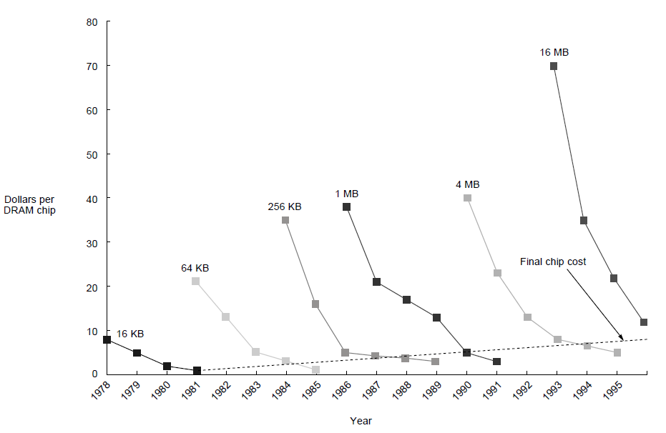
Prices of DRAMs over time in 1977 dollars
Prices of four generations of DRAMs over time in 1977 dollars, showing the learning curve at work. A1977 dollar is worth about $2.44 in 1995; most of this inflation occurred in the period of 1977–82, during which the value changed to $1.61. The cost of a megabyte of memory has dropped incredibly during this period, from over $5000 in 1977 to just over $6 in 1995 (in 1977 dollars)

Slide 15
Classes of Computers
Desktop and laptop computers
Designed to deliver good performance to a single user at low cost usually executing 3rd party software, usually incorporating a graphics display, a keyboard, and a mouse
Servers
Used to run larger programs for multiple, simultaneous users typically accessed only via a network and that places a greater emphasis on dependability and (often) security
Supercomputers
A high performance, high cost class of servers with hundreds to thousands of processors, terabytes of memory and petabytes of storage that are used for high-end scientific and engineering applications
Embedded computers (processors)
A computer inside another device used for running one predetermined application

Slide 16
Review: Some Basic Definitions
Kilobyte – 2¹⁰ or 1,024 bytes
Megabyte– 2²⁰ or 1,048,576 bytes
sometimes “rounded” to 10⁶ or 1,000,000 bytes
Gigabyte – 2³⁰ or 1,073,741,824 bytes
sometimes rounded to 10⁹ or 1,000,000,000 bytes
Terabyte – 2⁴⁰ or 1,099,511,627,776 bytes
sometimes rounded to 10¹² or 1,000,000,000,000 bytes
Petabyte – 2⁵⁰ or 1024 terabytes
sometimes rounded to 10¹⁵ or 1,000,000,000,000,000 bytes
Exabyte – 2⁶⁰ or 1024 petabytes
Sometimes rounded to 10¹⁸ or 1,000,000,000,000,000,000 bytes
Notes:
可以列举 大数据 的例子： http://tech.sina.com.cn/i/2012-08-23/10597538323.shtml
5000亿GB =5亿T = 50000 P =50E （2009 年）2020年将是2011年的 44 倍达到350亿TB
Fcebook基础设施工程副总裁杰·帕里克(Jay Parikh) Facebook每天处理的数据量多达500TB（1TB=1000GB）， 基础设施的容量为100PB
每天处理27亿次Like按钮点击。
每天上传3亿张图片。
每天由人工或系统自动执行的请求达到7万次。
每天吸收逾500TB新数据。

Slide 17
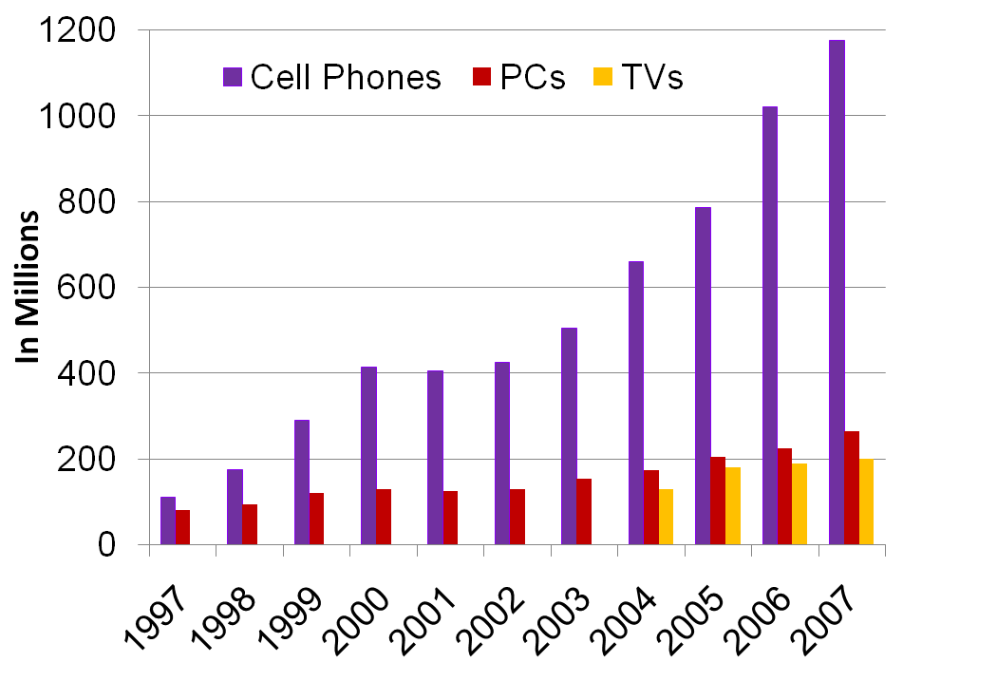
The Processor Market
embedded growth >> desktop growth
Where else are embedded processors found?

Slide 18
Embedded Processor Characteristics
The largest class of computers spanning the widest range of applications and performance
Often have minimum performance requirements. Example?
Often have stringent limitations on cost. Example?
Often have stringent limitations on power consumption. Example?
Often have low tolerance for failure. Example?
Notes:
stringent ['strin·gent || 'strɪndʒənt]
adj. 迫切的; 严厉的;

Slide 19
Understanding Performance
Algorithm
Determines number of operations executed
Programming language, compiler, ISA
Determine number of machine instructions executed per operation
Processor and memory system
Determine how fast instructions are executed
I/O system (including OS)
Determines how fast I/O operations are executed

Slide 20
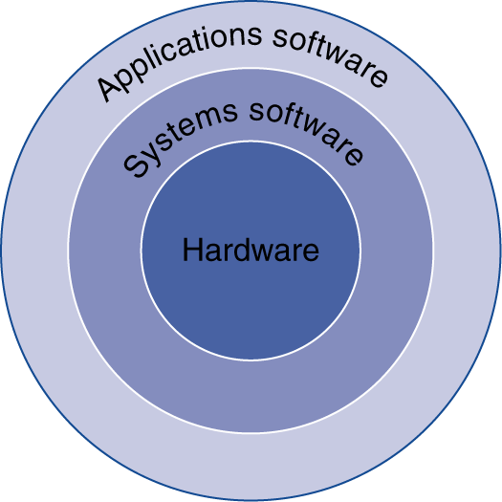
Below Your Program
Application software
Written in high-level language
System software
Compiler: translates HLL code to machine code
Operating System: service code
Handling input/output
Managing memory and storage
Scheduling tasks & sharing resources
Hardware
Processor, memory, I/O controllers
§1.2 Below Your Program

Slide 21
Levels of Program Code
High-level language program (in C)
void swap (int v[], int k)
{ int temp;
temp = v[k];
v[k] = v[k+1];
v[k+1] = temp;
}
Assembly language program (for MIPS)
swap: sll $2, $5, 2
add $2, $4, $2
lw $15, 0($2)
lw $16, 4($2)
sw $16, 0($2)
sw $15, 4($2)
jr $31
Machine (object, binary) code (for MIPS)
000000 00000 00101 0001000010000000
000000 00100 00010 0001000000100000
. . .
one-to-many
C compiler
one-to-one
assembler

Slide 22
Advantages of Higher-Level Languages ?
Higher-level languages
Allow the programmer to think in a more natural language and for their intended use (Fortran for scientific computation, Cobol for business programming, Lisp for symbol manipulation, Java for web programming, …)
Improve programmer productivity – more understandable code that is easier to debug and validate
Improve program maintainability
Allow programs to be independent of the computer on which they are developed (compilers and assemblers can translate high-level language programs to the binary instructions of any machine)
Emergence of optimizing compilers that produce very efficient assembly code optimized for the target machine
As a result, very little programming is done today at the assembler level

Slide 23
Instruction Set Architecture (ISA)
ISA, or simply architecture – the abstract interface between the hardware and the lowest level software that encompasses all the information necessary to write a machine language program, including instructions, registers, memory access, I/O, …
Enables implementations of varying cost and performance to run identical software
The combination of the basic instruction set (the ISA) and the operating system interface is called the application binary interface (ABI)
ABI – The user portion of the instruction set plus the operating system interfaces used by application programmers.
Defines a standard for binary portability across computers.
Notes:
ABI 中的操作系统的接口 例如 汇编语言中的系统中断调用 In 21H , BIOS中断调用 INT 16H键盘处理 INT 10H显示器中断

Slide 24
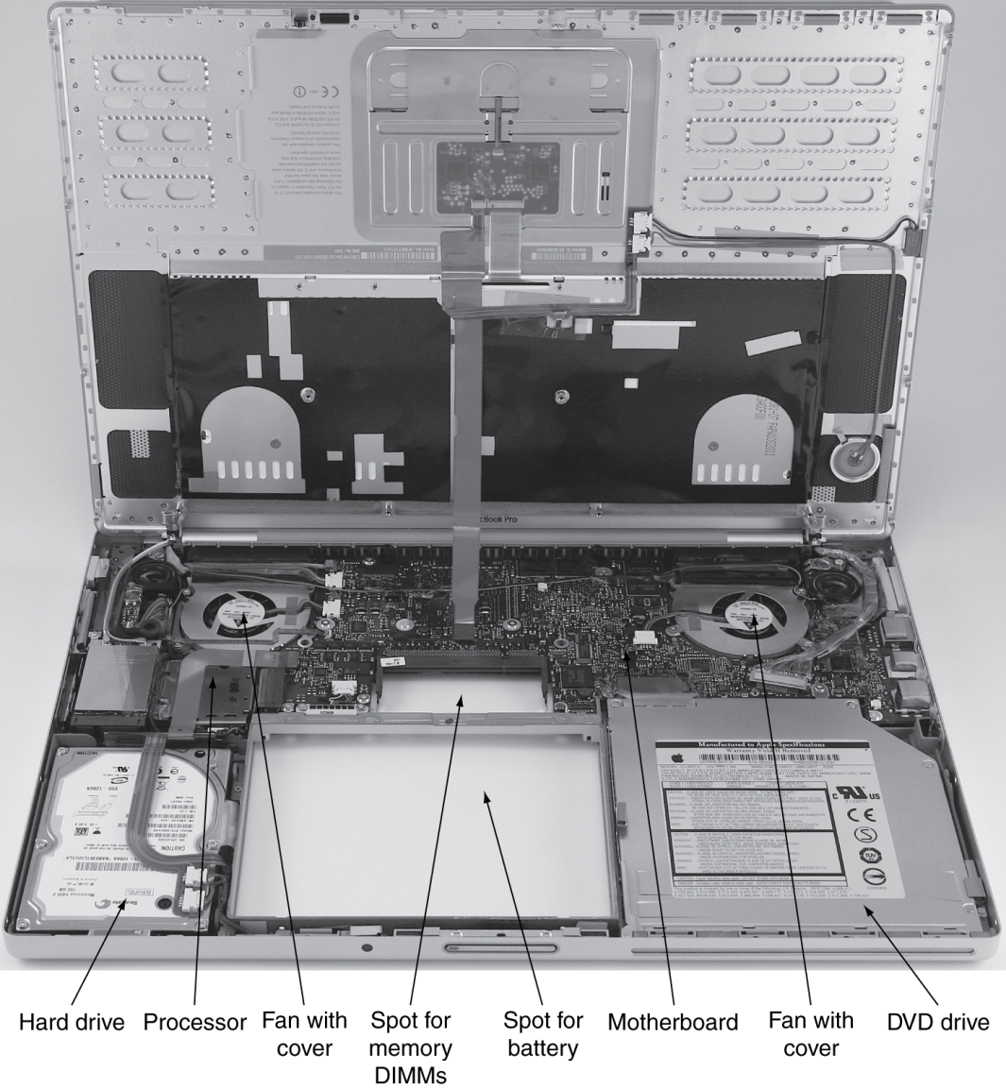
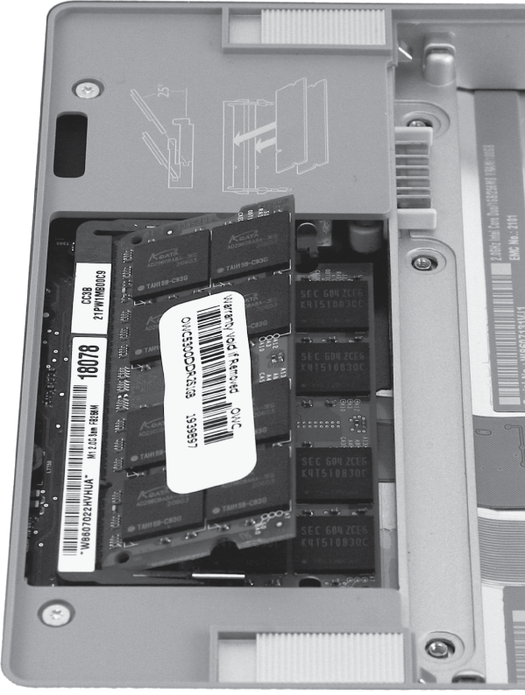
Opening the Box
Notes:
以上我们了解了各种应用程序都是会转换为机器指令，那么这些指令如何执行呢？
它是由什么来执行的？

Slide 25
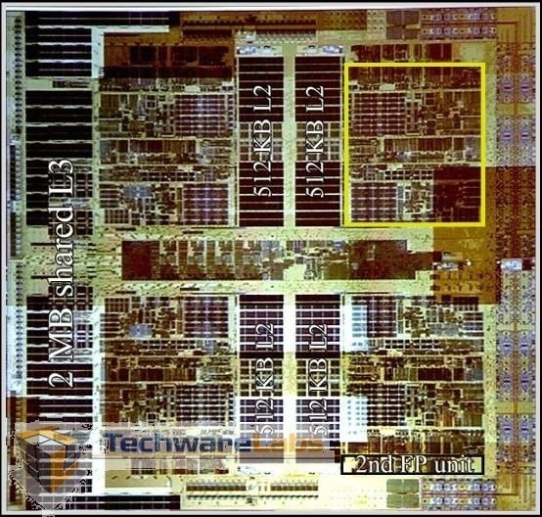
Inside the Processor
AMD’s Barcelona Multicore Chip
Four out-of-order cores on one chip
1.9 GHz clock rate
65nm technology
Three levels of caches (L1, L2, L3) on chip
Integrated Northbridge
Core 1
512KB L2
Core 2
512KB L2
2MB shared L3 Cache
Northbridge
512KB L2
Core 3
512KB L2
Core 4
Notes:
Four out-of-order cores on one chip ,四核乱序芯片

Slide 26
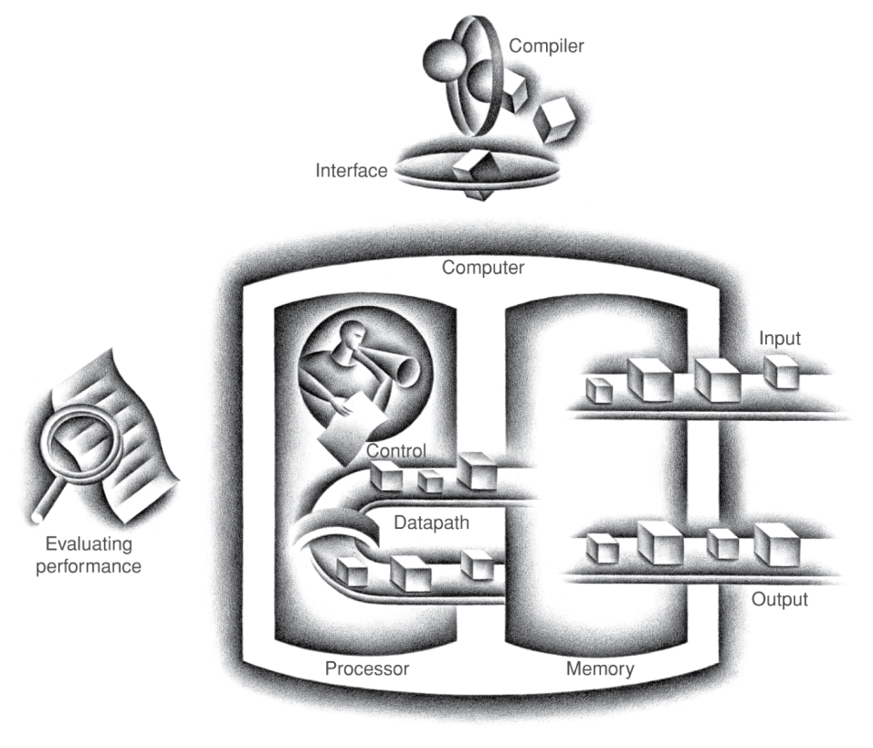
Components of a Computer
§1.3 Under the Covers
The BIG Picture
Five main components
Input, output, memory, datapath, control
Datapath + Control = Processor
Same components for all kinds of computers
Desktop, server, embedded
Input/output includes
User-interface devices, storage devices, network adapters
Notes:
以上我们了解了各种应用程序都是会转换为机器指令，那么这些指令如何执行呢？
它是由什么来执行的？

Slide 27
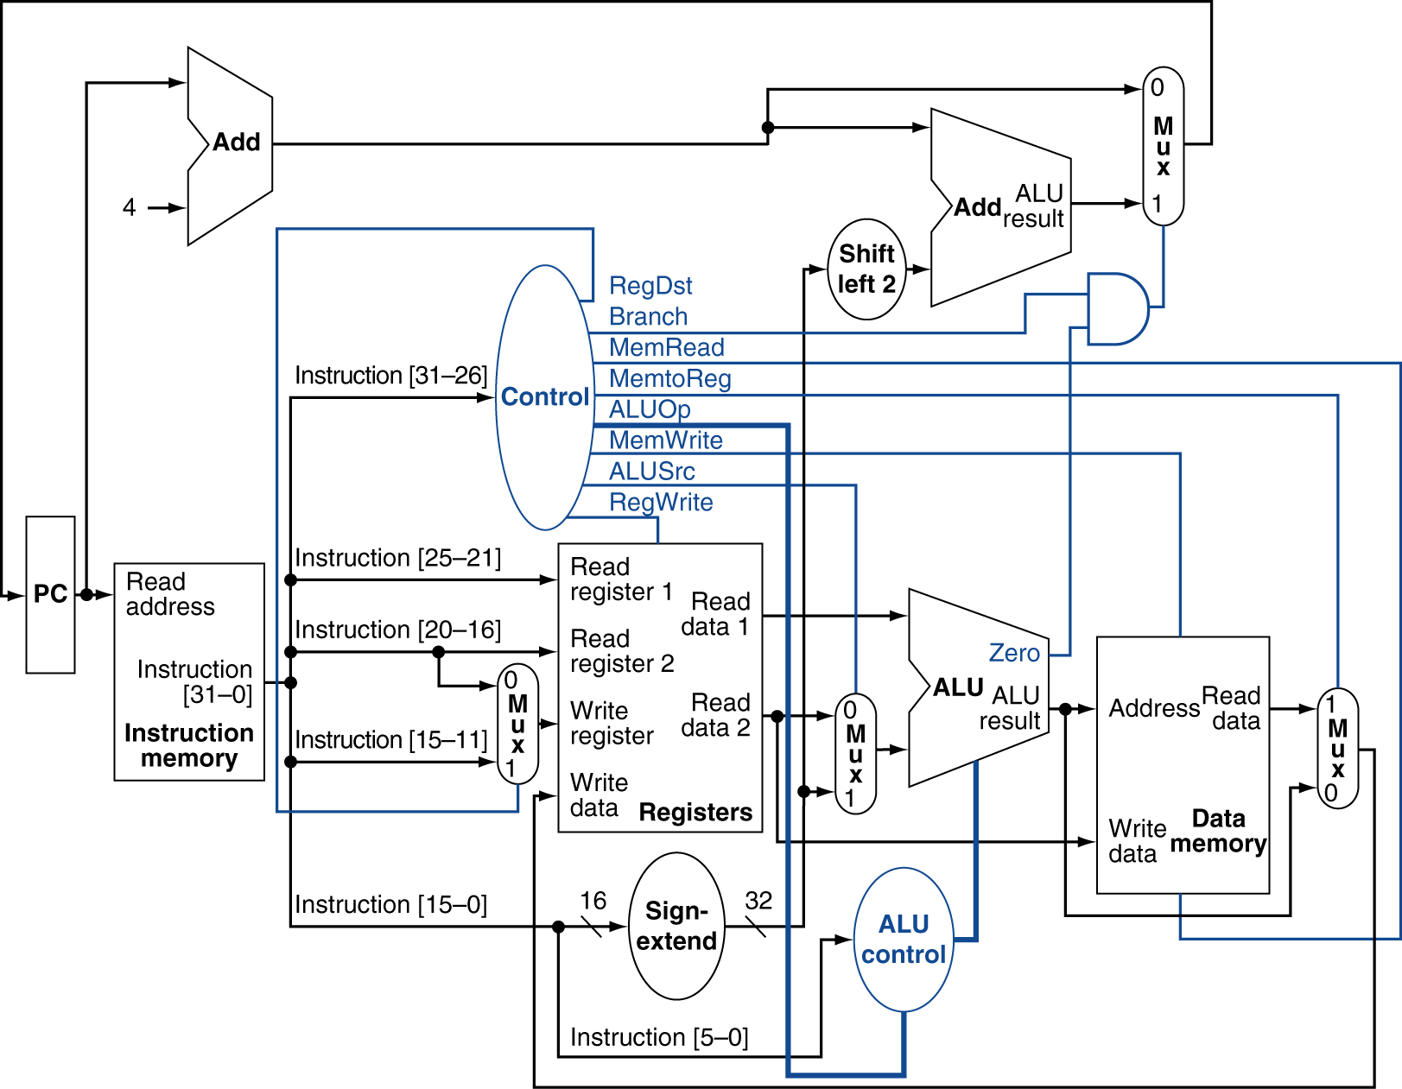
Inside the Processor

Slide 28
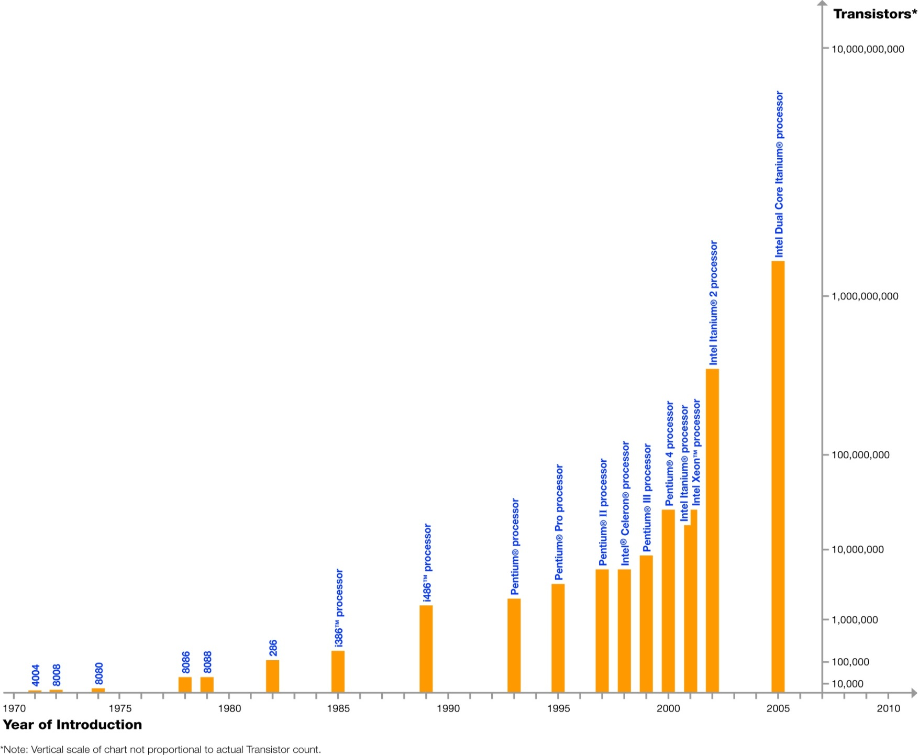
Moore’s Law？
In 1965, Intel’s Gordon Moore predicted that the number of transistors that can be integrated on single chip would double about every two years
Dual Core Itanium with 1.7B transistors
feature size
&
die size
Log Scale
Intel ®
Notes:
我们知道了程序是由计算机硬件的支撑下实现程序的功能，那么计算机的发展遵循什么样的规律？
目前又面临哪些问题呢？摩尔定律在未来还会成立吗？

Slide 29
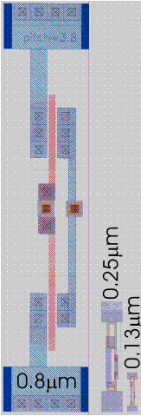
Technology Scaling
Key enabler for smaller, faster and more power efficient computing systems
Technology scaling has a threefold objective:
Increase the transistor density
Reduce the gate delay
Reduce the power consumption
Device dimensions (lateral and vertical) and voltages are reduced by 1/α (~0.7)
Technology generation spans 2-3 years
Notes:
技术定标：Technology Scaling

Slide 30
Technology Scaling Roadmap (ITRS)
Electronics technology continues to evolve
Increased capacity and performance; reduced cost
Year | 2006 | 2008 | 2010 | 2012 | 2014
Feature size (nm) | 90 | 65 | 45 | 32 | 22
Intg. Capacity (BT) | 2 | 4 | 6 | 16 | 32
Fun facts about 45nm transistors
30 million can fit on the head of a pin
You could fit more than 2,000 across the width of a human hair
If car prices had fallen at the same rate as the price of a single transistor has since 1968, a new car today would cost about ?
1 cent
Notes:
ITRS （国际半导体技术蓝图）

Slide 31
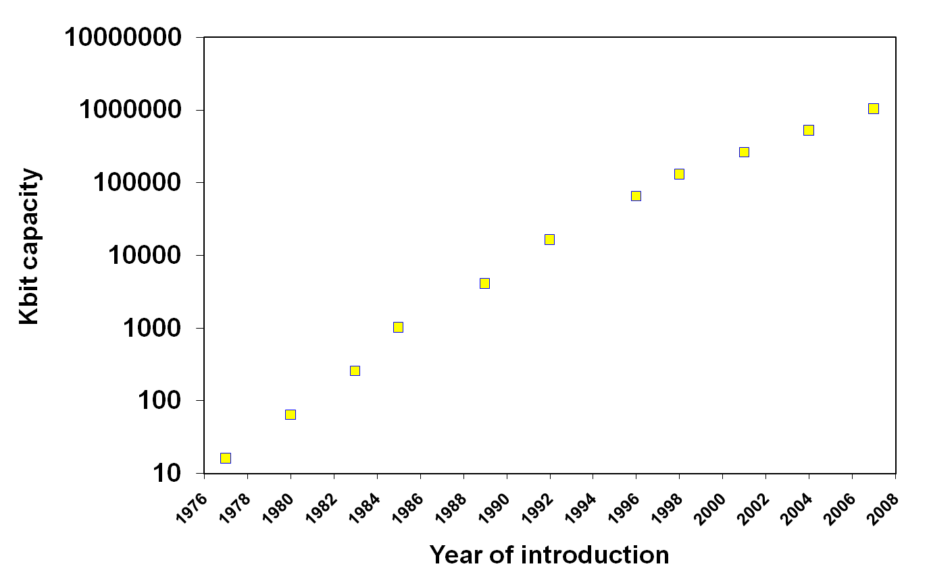
Another Example of Moore’s Law Impact
DRAM capacity growth over 3 decades
1G
256M
64M
512M
128M
4M
16M
1M
64K
256K
16K

Slide 32
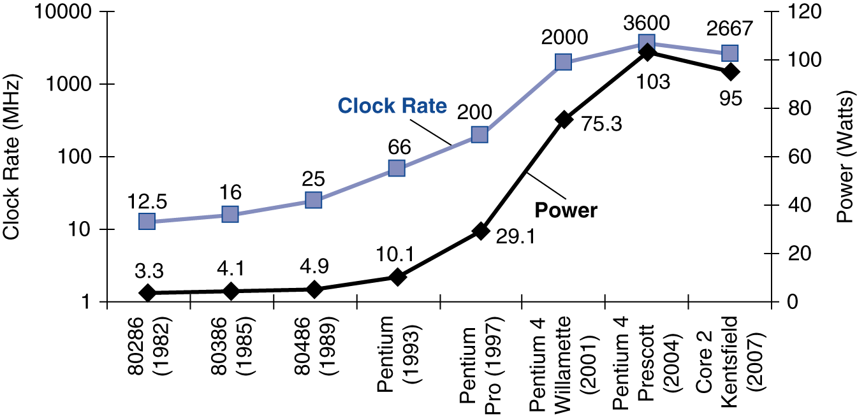
Power Trends
§1.5 The Power Wall
In CMOS IC technology
×30
5V → 1V
×1000
Notes:
Packaging issues for laptop and desktop PC set the “power” limit at 100 Watts.

Slide 33
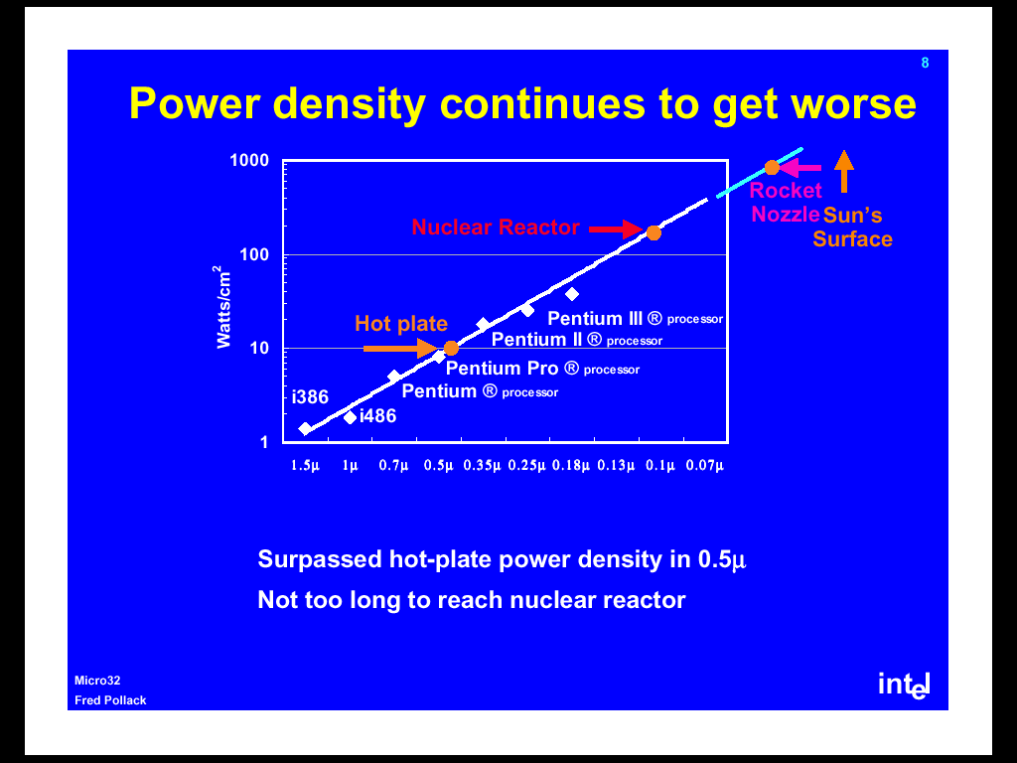
Power Density Getting Worse
Notes:
Hot plate

Slide 34
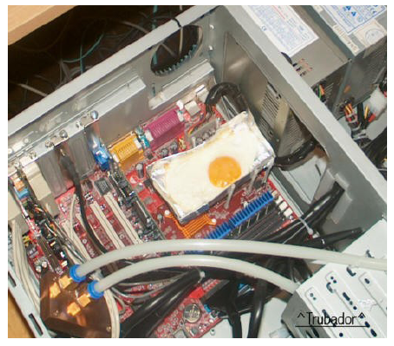
Surpassed hot (kitchen) plate … why not use it?

Slide 35
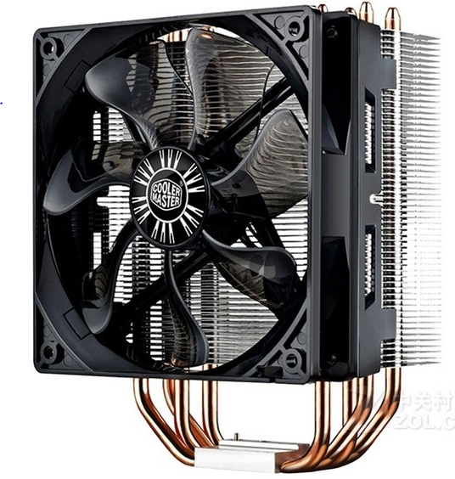
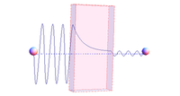
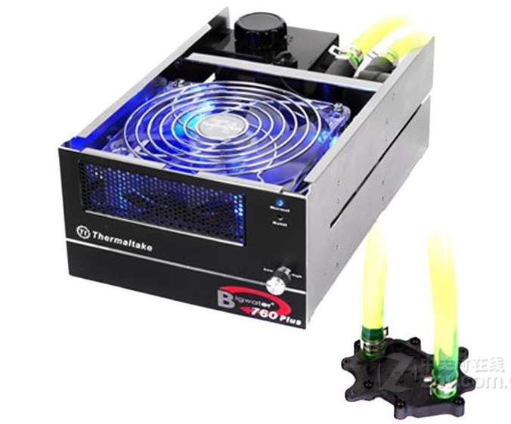
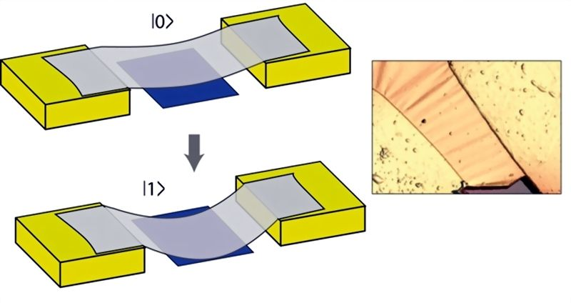
散热\隧道效应

Slide 36
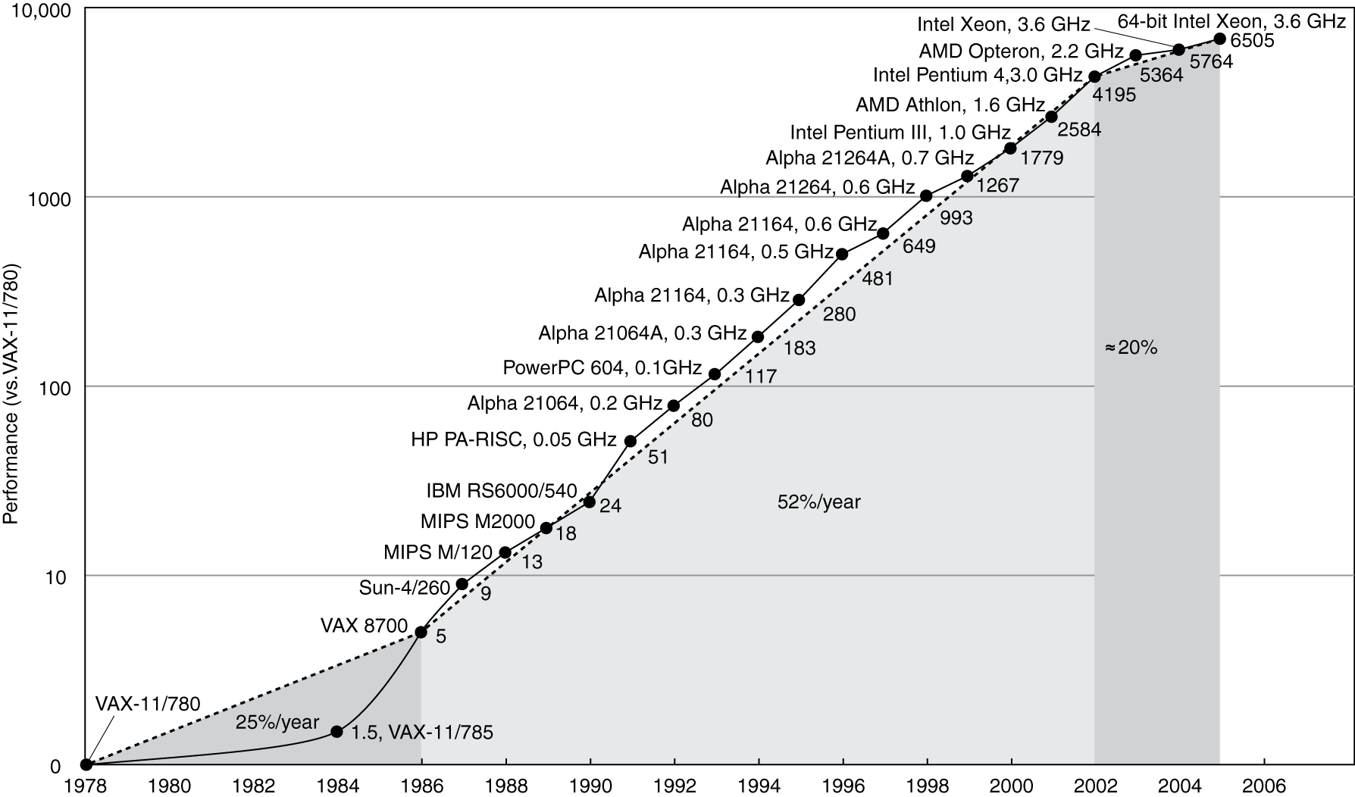
Uniprocessor Performance
§1.6 The Sea Change: The Switch to Multiprocessors
Constrained by power, instruction-level parallelism, memory latency
Notes:
Uniprocessor单处理机(单机

Slide 37
The Sea Change
The power challenge has forced a change in the design of microprocessors
Since 2002 the rate of improvement in the response time of programs on desktop computers has slowed from a factor of 1.5 per year to less than a factor of 1.2 per year
As of 2006 all desktop and server companies are shipping microprocessors with multiple processors – cores – per chip
Product | AMD Barcelona | Intel Nehalem | IBM Power 6 | Sun Niagara 2
Cores per chip | 4 | 4 | 2 | 8
Clock rate | 2.5 GHz | ~2.5 GHz? | 4.7 GHz | 1.4 GHz
Power | 120 W | ~100 W? | ~100 W? | 94 W
Plan of record is to double the number of cores per chip per generation (about every two years)
Notes:
Sea Change：突变, 突发性彻底转变

Slide 38
Why Multiple Cores on a Chip?
Power
Cache
Power = 1/4
Large Core
4
Performance
Performance = 1/2
3
2
2
Small
Core
1
1
1
1
C1
C2
4
4
Multi-Core:
Power efficient
Better power and thermal management
3
3
Cache
C3
C4
2
2
1
1
Notes:
thermal 热量 管理, How to program on multiple cores system to utilize the hardware resources efficiently?

Slide 39
Performance Metrics
§1.4 Performance
Purchasing perspective
given a collection of machines, which has the
best performance ?
least cost ?
best cost/performance?
Design perspective
faced with design options, which has the
best performance improvement ?
least cost ?
best cost/performance?
Both require
basis for comparison
metric for evaluation
Our goal is to understand what factors in the architecture contribute to overall system performance and the relative importance (and cost) of these factors

Slide 40
Defining Performance
Which airplane has the best performance?
Notes:
Concorde [kɔn'kɔ:d]
n. 协和式（飞机）

Slide 41
Response Time and Throughput
Response time
How long it takes to do a task
Important to individual users
Throughput
Total work done per unit time
e.g., tasks/transactions/… per hour
Important to data center managers
How are response time & throughput affected by
Replacing the processor with a faster version?
Adding more processors?
We’ll focus on response time for now…
Notes:
如同 比较飞机的性能，可以从载客量和飞行速度两方面来衡量飞机的性能
计算机系统也可以 吞吐量 和响应时间来考虑
我们 主要管组响应时间。 因为，响应时间缩短，也可以提高吞吐量，此外还需要更多的处理器来提高吞吐量。

Slide 42
Relative Performance
Define Performance = 1/Execution Time
“X is n time faster than Y”
Example: time taken to run a program
10s on A, 15s on B
Execution Time_{B} / Execution Time_{A} = 15s / 10s = 1.5
So A is 1.5 times faster than B
Notes:
相对性能，比较两个计算机可以根据执行相同任务花费的时间来比较
那么这种比较科学吗？或者完备吗？

Slide 43
Measuring Execution Time
Execution time: seconds/program
Elapsed time (wall clock time)
Total response time, including all aspects
Processing, I/O, OS overhead, idle time
Determines system performance
CPU time
Time spent processing a given job
Discounts I/O time, other jobs’ shares
Comprises user CPU time and system CPU time
Different programs are affected differently by CPU and system performance
Notes:
逝去时间（根据强上的时钟来衡量），有可能受很多因素的影响，例如操作系统，输入输出、系统负载状态等
更精确的衡量计算机系统的性能可以通过CPU时间来衡量

Slide 44
CPU Clocking: Review
Operation of digital hardware governed by a constant-rate clock
Clock period
Clock (cycles)
Data transfer and computation
Update state
Clock period: duration of a clock cycle
e.g., 250ps = 0.25ns = 250×10^{–12}s
Clock frequency (rate): cycles per second
e.g., 4.0GHz = 4000MHz = 4.0×10⁹Hz
Notes:
时钟周期 和时钟频率

Slide 45
CPU Clocking: Review
Clock rate (clock cycles per second in MHz or GHz) is inverse of clock cycle time (clock period)
CC = 1 / CR
10 nsec clock cycle => 100 MHz clock rate
5 nsec clock cycle => 200 MHz clock rate
2 nsec clock cycle => 500 MHz clock rate
1 nsec (10⁻⁹) clock cycle => 1 GHz (10⁹) clock rate
500 psec clock cycle => 2 GHz clock rate
250 psec clock cycle => 4 GHz clock rate
200 psec clock cycle => 5 GHz clock rate

Slide 46
CPU Time
Performance improved by
Reducing number of clock cycles
Increasing clock rate
Hardware designer must often trade off clock rate against cycle count
Many techniques that decrease the number of clock cycles also increase the clock cycle time
Notes:
需要在CPU周期数和时钟频率之间进行折中
很多技术降低了时钟的数量，但是也会提高时钟周期的时间

Slide 47
CPU Time Example
A program runs on computer A with a 2 GHz clock in 10 seconds. Unfortunately, to accomplish this, computer B will require 1.2 times as many clock cycles as computer A to run the program. What clock rate must computer B run at to run this program in 6 seconds?
Notes:
In most cases, you cannot expect performance to double just by doubling clock frequency

Slide 48
Instruction Count and CPI
Instruction Count for a program
Determined by program, ISA and compiler
Average cycles per instruction
Determined by CPU hardware
If different instructions have different CPI
Average CPI affected by instruction mix
Notes:
指令数量 和CPI（平均每条指令的时钟周期数）

Slide 49
CPI Example
Computer A: Cycle Time = 250ps, CPI = 2.0
Computer B: Cycle Time = 500ps, CPI = 1.2
Same ISA
Which is faster, and by how much?
A is faster…
…by this much
Notes:
计算CPU时间似乎我们的问题得到解决了？ 因为一个程序执行的指令数比较容易确定，CPI也确定了，那么计算机的性能似乎很容易评价？是真的吗？

Slide 50
CPI in More Detail
If different instruction classes take different numbers of cycles
Weighted average CPI
Relative frequency
Notes:
CPI 是恒定的吗？ CPI容易计算吗？
因为 计算机中不同的指令的CPI是不同的，因此系统的CPI与执行的程序有关。为了说明该问题，下面我们举一个例子说明

Slide 51
CPI Example
Alternative compiled code sequences using instructions in classes A, B, C. What is avg. CPI?
Class | A | B | C
CPI for class | 1 | 2 | 3
IC in sequence 1 | 2 | 1 | 2
IC in sequence 2 | 4 | 1 | 1
Sequence 1: IC = 5
Clock Cycles = 2×1 + 1×2 + 2×3 = 10
Avg. CPI = 10/5 = 2.0
Sequence 2: IC = 6
Clock Cycles = 4×1 + 1×2 + 1×3 = 9
Avg. CPI = 9/6 = 1.5
Notes:
2个程序，具有不同的IC （ 指令数）， 程序编译成ABC3类指令，其CPI不同
这意味着 不同程序的CPI是不同的

Slide 52
Performance Summary
The BIG Picture
 | Instruction_count | CPI | clock_cycle
Algorithm
Programming language
Compiler
ISA
Core organization
Technology
X
X
X
X
X
X
X
X
X
X
X
X
Notes:
下面我们举个例子说明CPI对系统性能的影响

Slide 53
Workloads and Benchmarks
Benchmarks – a set of programs that form a “workload” specifically chosen to measure performance
SPEC (System Performance Evaluation Cooperative) creates standard sets of benchmarks starting with SPEC89. The SPEC CPU2006 which consists of 12 integer benchmarks (CINT2006) and 17 floating-point benchmarks (CFP2006).
www.spec.org
There are also benchmark collections for power workloads (SPECpower_ssj2008), for mail workloads (SPECmail2008), for multimedia workloads (mediabench), …
Notes:
由于 采用相同的指令集架构，其CPI与运行的程序有关？那么如何来衡量系统性能呢？
目前就是 采用一组具有典型代表性的应用来综合衡量一个系统的性能

Slide 54
CINT2006 for Opteron X4 2356
Name | Description | IC×10⁹ | CPI | Tc (ns) | Exec time | Ref time | SPECratio
perl | Interpreted string processing | 2,118 | 0.75 | 0.4 | 637 | 9,777 | 15.3
bzip2 | Block-sorting compression | 2,389 | 0.85 | 0.4 | 817 | 9,650 | 11.8
gcc | GNU C Compiler | 1,050 | 1.72 | 0.4 | 24 | 8,050 | 11.1
mcf | Combinatorial optimization | 336 | 10.00 | 0.4 | 1,345 | 9,120 | 6.8
go | Go game (AI) | 1,658 | 1.09 | 0.4 | 721 | 10,490 | 14.6
hmmer | Search gene sequence | 2,783 | 0.80 | 0.4 | 890 | 9,330 | 10.5
sjeng | Chess game (AI) | 2,176 | 0.96 | 0.4 | 37 | 12,100 | 14.5
libquantum | Quantum computer simulation | 1,623 | 1.61 | 0.4 | 1,047 | 20,720 | 19.8
h264avc | Video compression | 3,102 | 0.80 | 0.4 | 993 | 22,130 | 22.3
omnetpp | Discrete event simulation | 587 | 2.94 | 0.4 | 690 | 6,250 | 9.1
astar | Games/path finding | 1,082 | 1.79 | 0.4 | 773 | 7,020 | 9.1
xalancbmk | XML parsing | 1,058 | 2.70 | 0.4 | 1,143 | 6,900 | 6.0
Geometric mean |  |  |  |  |  |  | 11.7
High cache miss rates

Slide 55
Comparing and Summarizing Performance
How do we summarize the performance for benchmark set with a single number?
First the execution times are normalized giving the “SPEC ratio” (bigger is faster, i.e., SPEC ratio is the inverse of execution time)
The SPEC ratios are then “averaged” using the geometric mean (GM)
n
GM = n Π SPEC ratio_{i}
i = 1
Guiding principle in reporting performance measurements is reproducibility – list everything another experimenter would need to duplicate the experiment (version of the operating system, compiler settings, input set used, specific computer configuration (clock rate, cache sizes and speed, memory size and speed, etc.))
Notes:
除了几何平均之外，还有 加权平均、算术平均等方式来度量相对性能

Slide 56
Pitfall: Amdahl’s Law
Amdahl’s law: performance enhancement possible with a given improvement is limited by the amount that the improved feature is used
Pitfall: Improving an aspect of a computer and expecting a proportional improvement in overall performance
§1.8 Fallacies and Pitfalls
Example: multiply accounts for 80s/100s
How much improvement in multiply performance to get 5× overall?
Can’t be done!
Corollary: make the common case fast
Notes:
corollary [co·rol·lar·y || kə'rɒlərɪ]
n. 必然的结果; 推论;
pitfall
n. 陷阱, 阴谋, 诱惑

Slide 57
A Simple Example
Op | Freq | CPI_{i} | Freq x CPI_{i}
ALU | 50% | 1
Load | 20% | 5
Store | 10% | 3
Branch | 20% | 2
 |  |  | Σ =
.5
1.0
.3
.4
.5
.4
.3
.4
.5
1.0
.3
.2
.25
1.0
.3
.4
2.2
1.6
2.0
1.95
How much faster would the machine be if a better data cache reduced the average load time to 2 cycles?
How does this compare with using branch prediction to shave a cycle off the branch time?
What if two ALU instructions could be executed at once?
CPU time new = 1.6 x IC x CC so 2.2/1.6 means 37.5% faster
CPU time new = 2.0 x IC x CC so 2.2/2.0 means 10% faster
CPU time new = 1.95 x IC x CC so 2.2/1.95 means 12.8% faster
Notes:
我们举个简单的例子来说明CPI的计算 如何通过降低CPI来提升性能
1） 通过Cahe技术来降低Load指令
2） 通过分支预测技术提高分支指令
3） 通过提高ALU的性能

Slide 58
SPEC Power Benchmark
Power consumption of server at different workload levels
Performance: ssj_ops/sec (server side java ops/sec)
Power: Watts (Joules/sec)
Notes:
采用单位功率下 处理事务的能力 吞吐率

Slide 59
SPECpower_ssj2008 for X4
Target Load % |  | Performance (ssj_ops/sec) |  | Average Power (Watts)
100% |  | 231,867 |  | 295
90% |  | 211,282 |  | 286
80% |  | 185,803 |  | 275
70% |  | 163,427 |  | 265
60% |  | 140,160 |  | 256
50% |  | 118,324 |  | 246
40% |  | 920,35 |  | 233
30% |  | 70,500 |  | 222
20% |  | 47,126 |  | 206
10% |  | 23,066 |  | 180
0% |  | 0 |  | 141
Overall sum |  | 1,283,590 |  | 2,605
∑ssj_ops/ ∑power |  |  |  | 493
Notes:
AMD Opteron X4

Slide 60
Fallacy: Low Power at Idle
Look back at X4 power benchmark
At 100% load: 295W
At 50% load: 246W (83%)
At 10% load: 180W (61%)
Google data center
Mostly operates at 10% – 50% load
At 100% load less than 1% of the time
Consider designing processors to make power proportional to load
Notes:
由于 负载与能耗之间并不是呈现线性关系，因此云计算中心的目的就是提高单台物理机器的利用率。

Slide 61
Pitfall: MIPS as a Performance Metric
MIPS: Millions of Instructions Per Second
If used as a metric to compare computers:
Doesn’t account for differences in instruction complexity
Different ISAs may lead to different instruction counts for same program
MIPS varies between programs on the same computer!
Computer cannot have a single MIPS rating
e.g. CPI varied by 13x for SPEC2006 on AMD Opteron X4, so MIPS does as well

Slide 62
Integrated Circuit Cost
Nonlinear relation to area and defect rate
Wafer cost and area are fixed
Defect rate determined by manufacturing process
Die area determined by architecture and circuit design

Slide 63
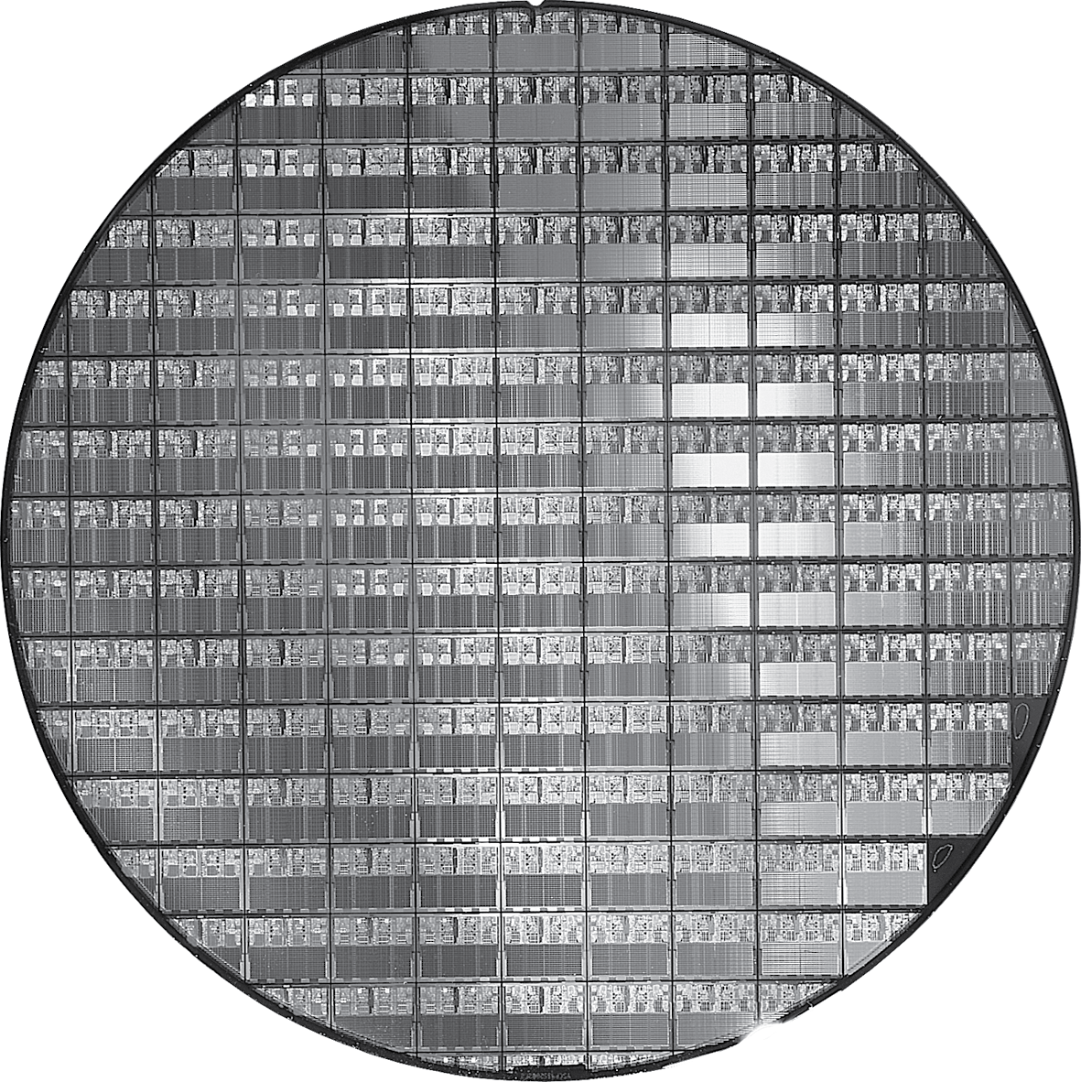
AMD Opteron X2 Wafer
X2: 300mm wafer, 117 chips, 90nm technology
X4: 45nm technology
Notes:
Wafer 晶片, 薄饼, 圆片 , 300mm ~=12 英寸，目前最先进的是14英寸的生产线

Slide 64
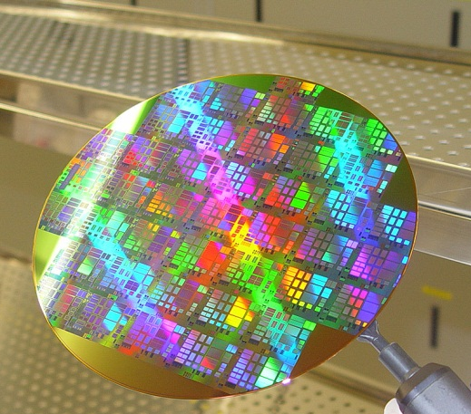

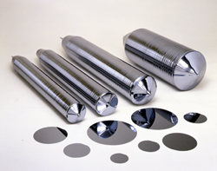



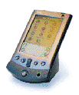



芯片的产生与应用示意
硅: 来源于沙子

Slide 65
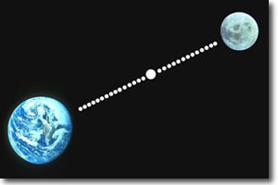
Purity of Silicon of chips
硅体材料纯度达到 99.9999999%
Only allow one purity in 10B atoms —— equivalent to one defect in the Pin-Pon balls filled in between Earth and Moon.

Slide 66
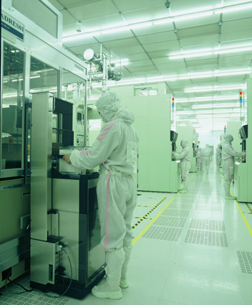
Purity of Manufacturing enviroments
洁净度是药品制造的1000倍。
洁净空气
晶圆: 不能用手直接拿取
操作者—— 必须穿洁净 工作服

Slide 67
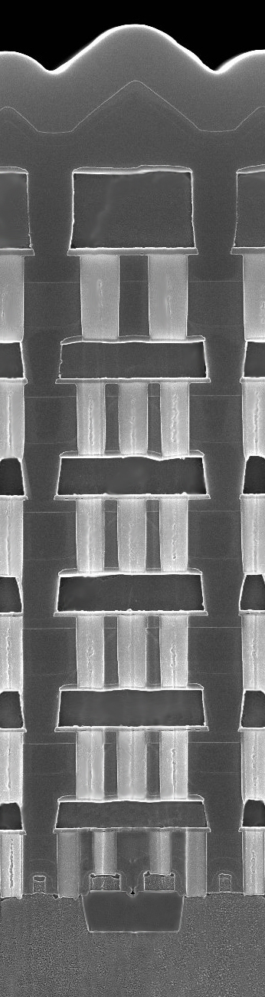
分层结构
Passivation SiN
Top-Metal
Top-Via
5-Metal
4-Via
4-Metal
3-Via
3-Metal
2-Via
2-Metal
1-Via
0.15 μm 逻辑电路分层结构:
共30层光掩膜
总共需600多步骤制造
1-Metal
Contact
POLY
STI
0.15 μm1P6M logic

Slide 68
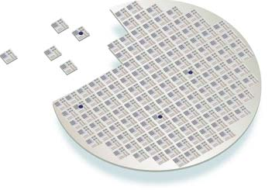


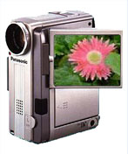
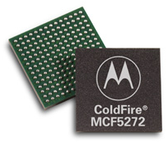
IC Industrial Chain
设计
晶园材料
光掩膜
芯片制造
系统制造商
前端工艺
封装
后端工艺
测试

Slide 69
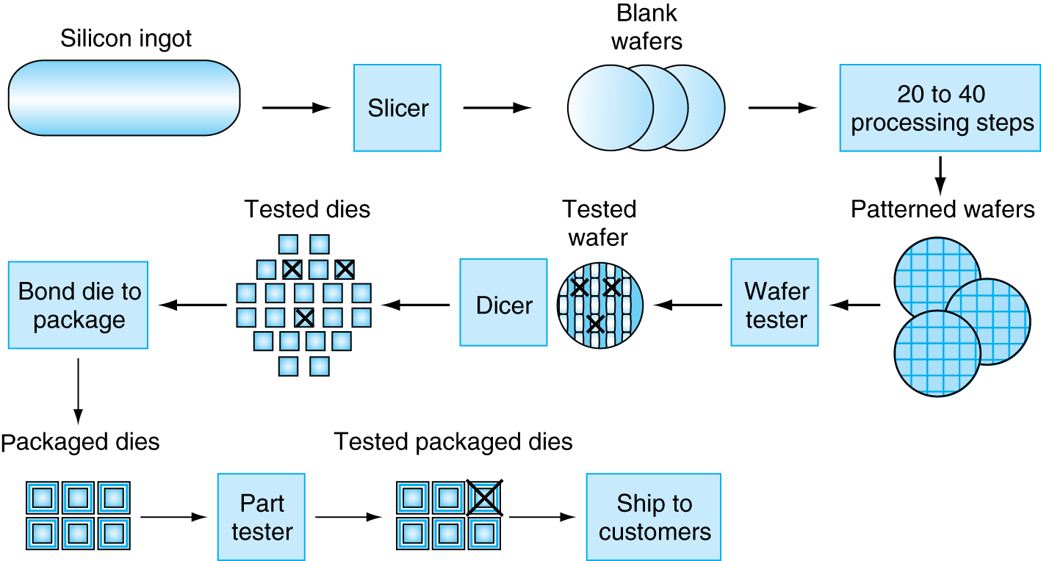
Manufacturing ICs
§1.7 Real Stuff: The AMD Opteron X4
Yield: proportion of working dies per wafer

Slide 70
Concluding Remarks
Cost/performance is improving
Due to underlying technology development
Hierarchical layers of abstraction
In both hardware and software
Instruction set architecture
The hardware/software interface
Execution time: the best performance measure!
Power is a limiting factor
Use parallelism to improve performance
§1.9 Concluding Remarks

Slide 71
Assignment 1
Homework assignment
1.1 ~1.4 , 1.6 ~1.8 , 1.13
To be submitted to Sakai
File Format： Word or PDF
Read
Chapter 1 of P&H
The First Draft Report on the EDVAC

